Slide 1
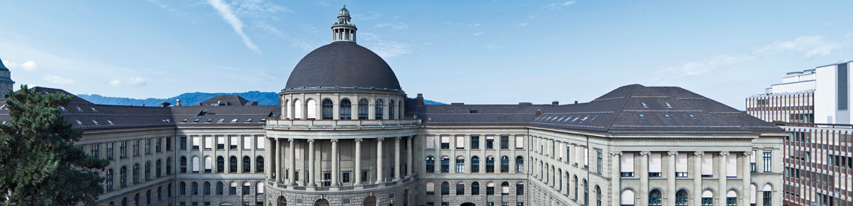
Neural Style Transfer for US imaging
Results from 1st week

Slide 2
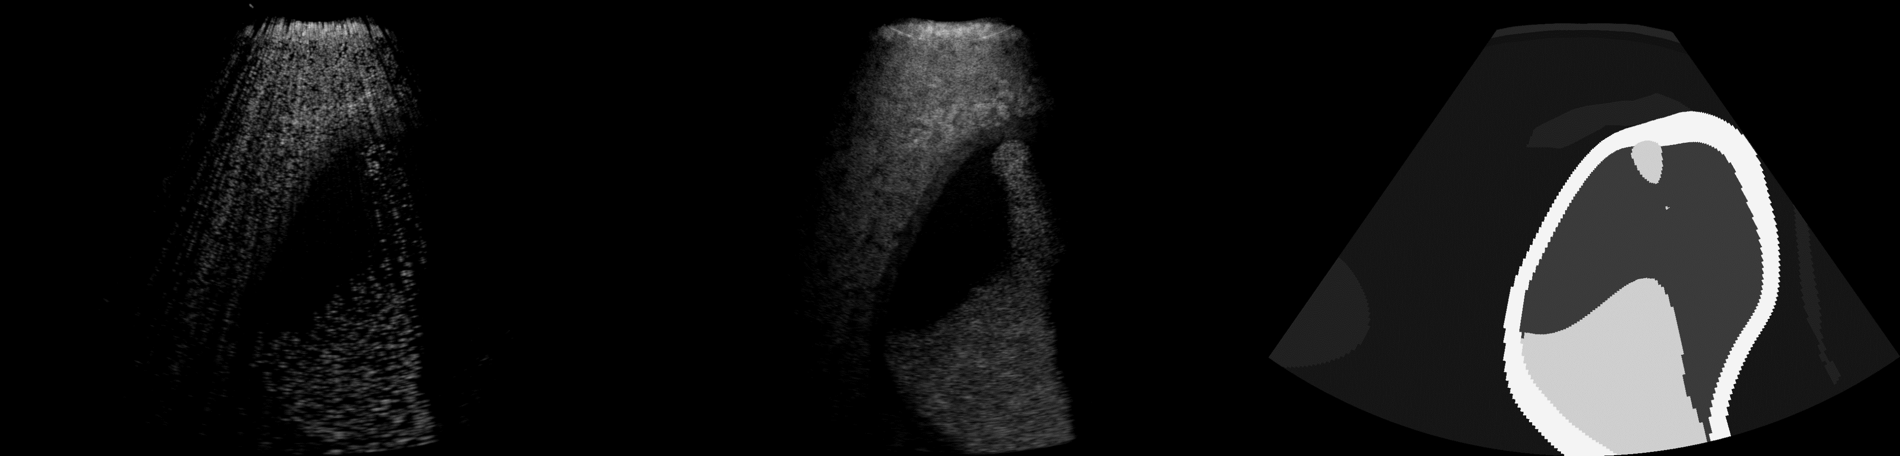

LQ to HQ
Content
Style

Slide 3
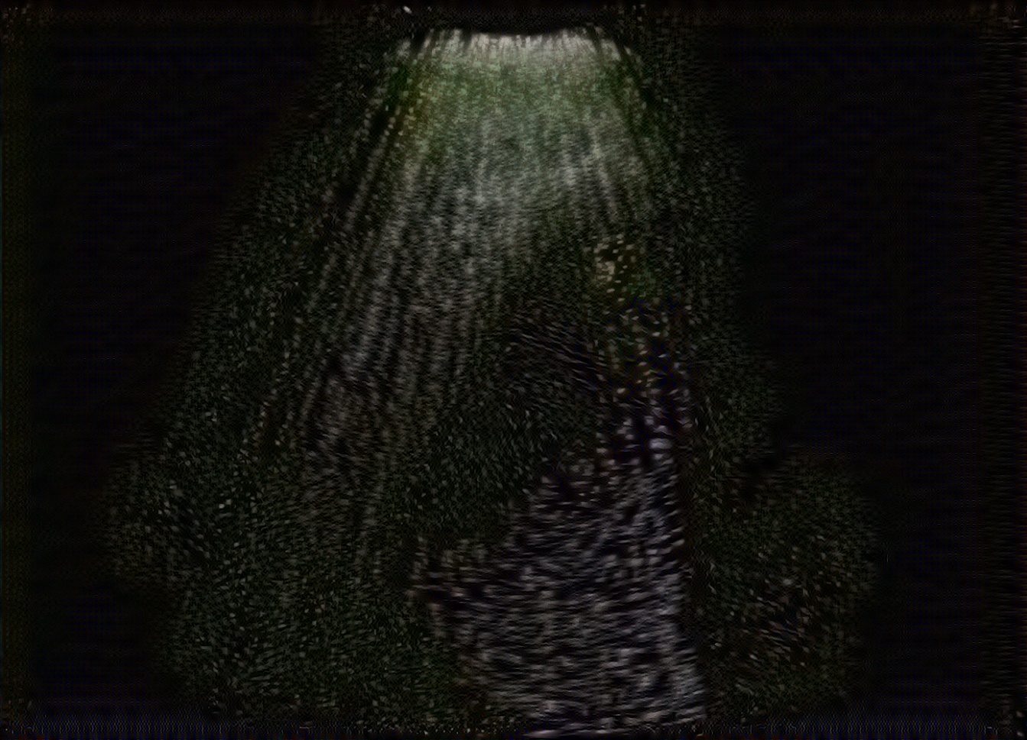
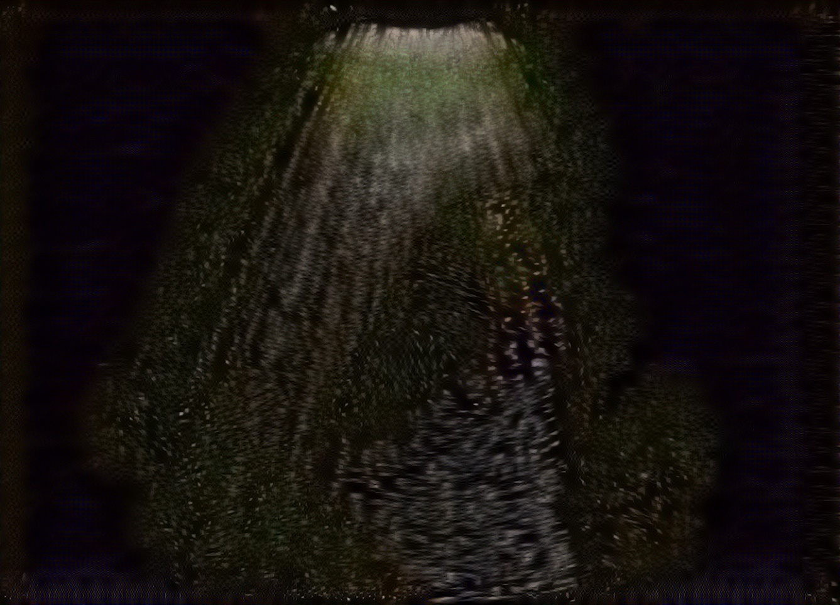
LQ to HQ - Optimization process - 1 10 epochs (1-2)
Note: RGB because the layers of the network have 3 channels.

Slide 4
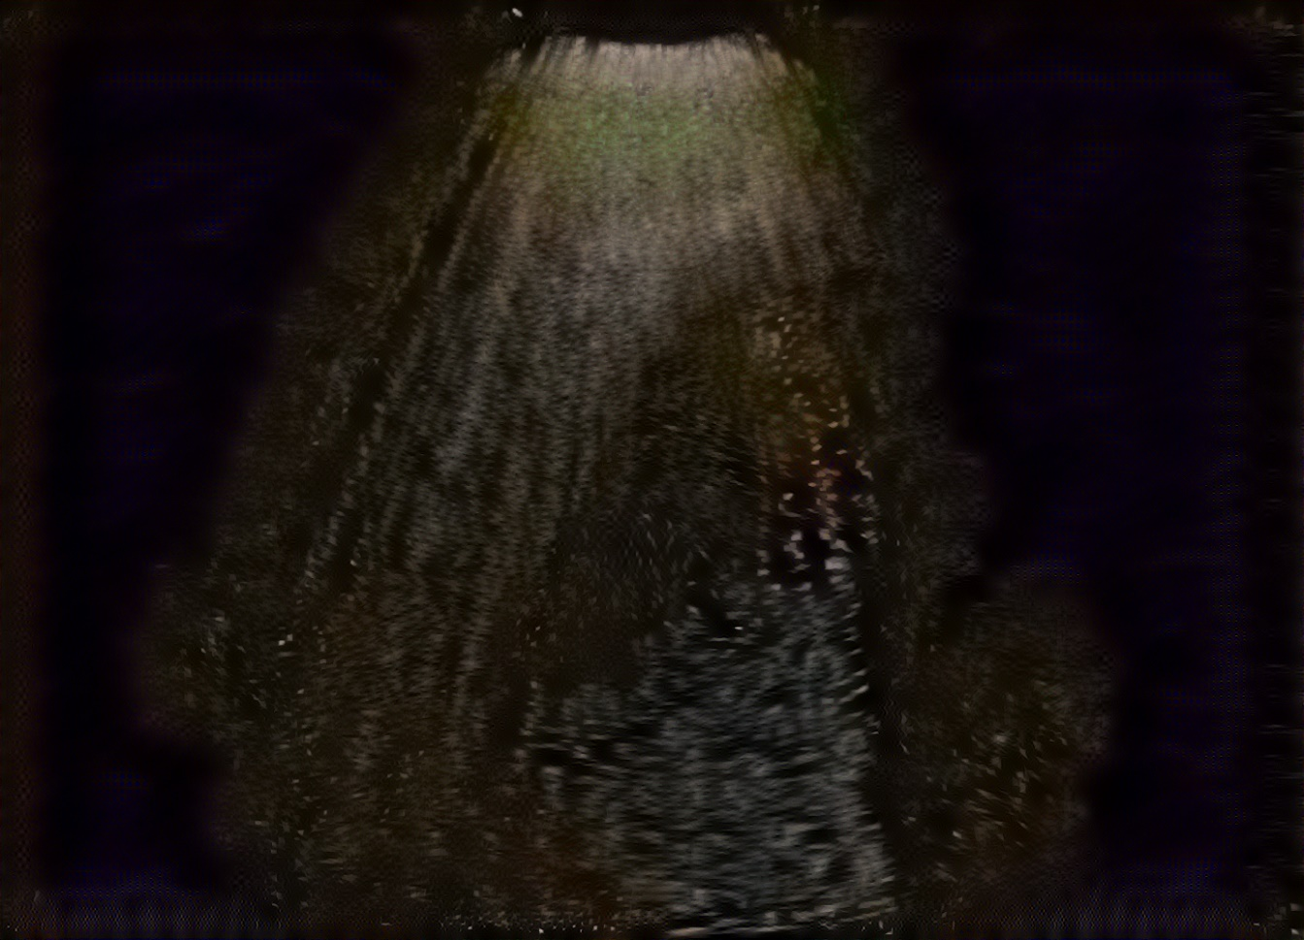
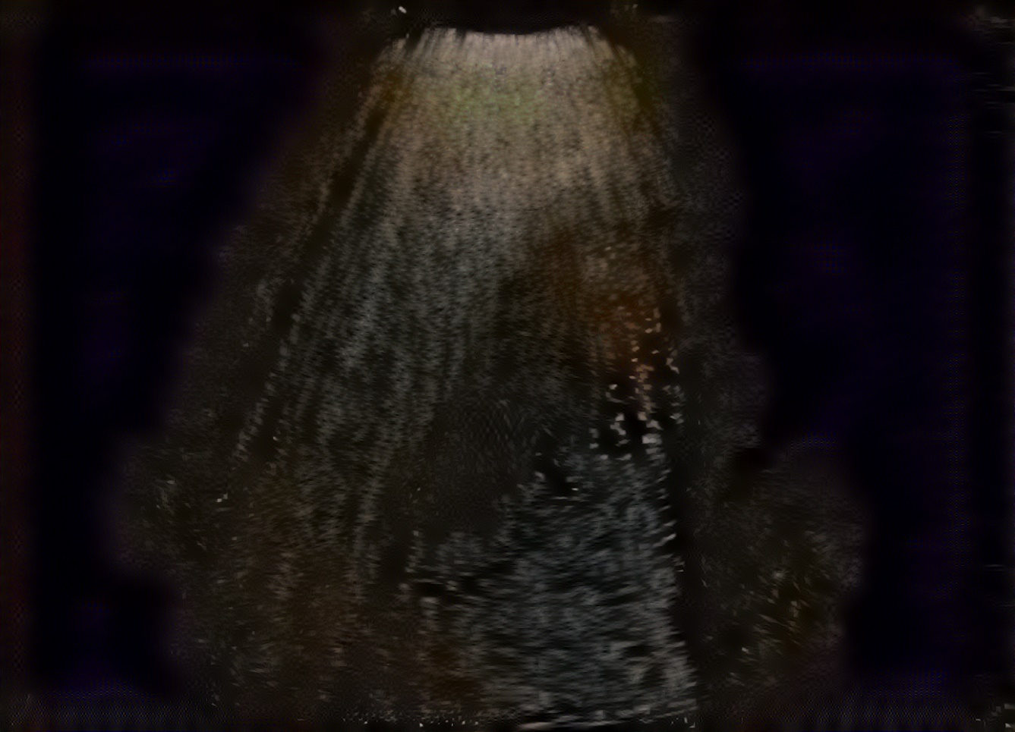
LQ to HQ - Optimization process - 2 10 epochs (3-4)

Slide 5
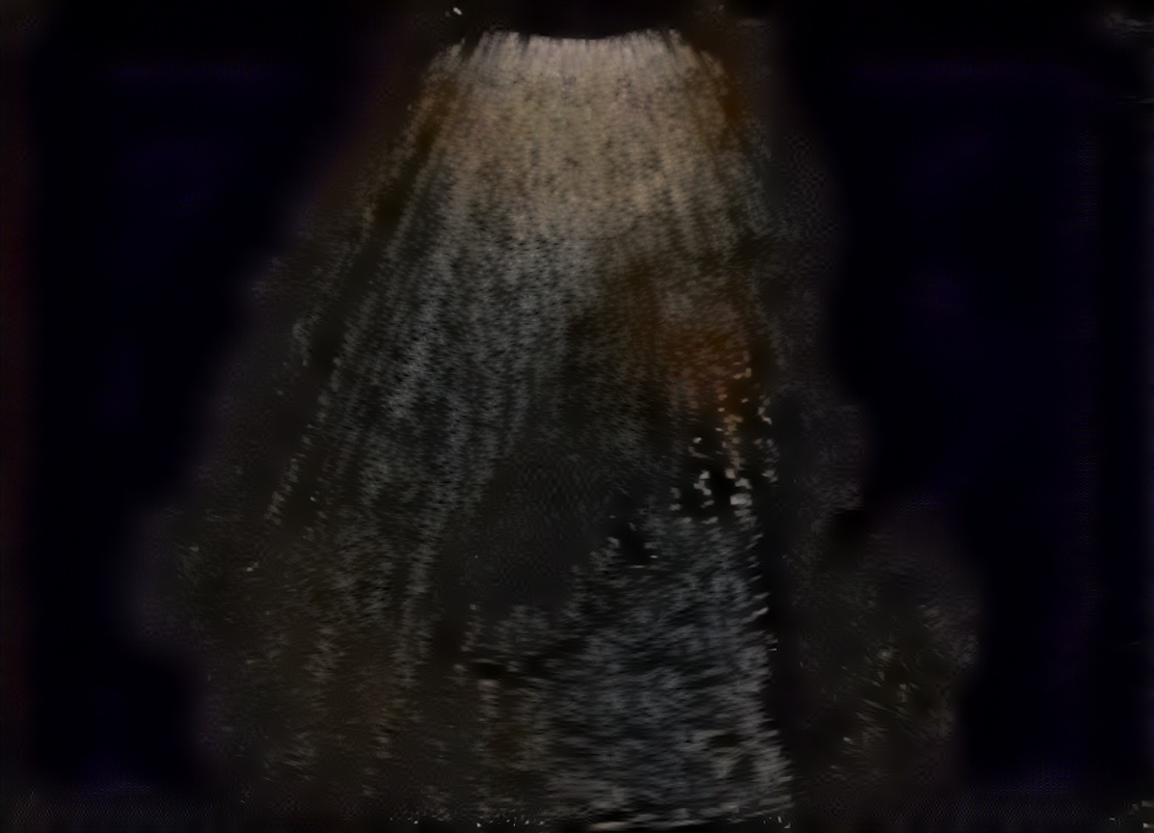
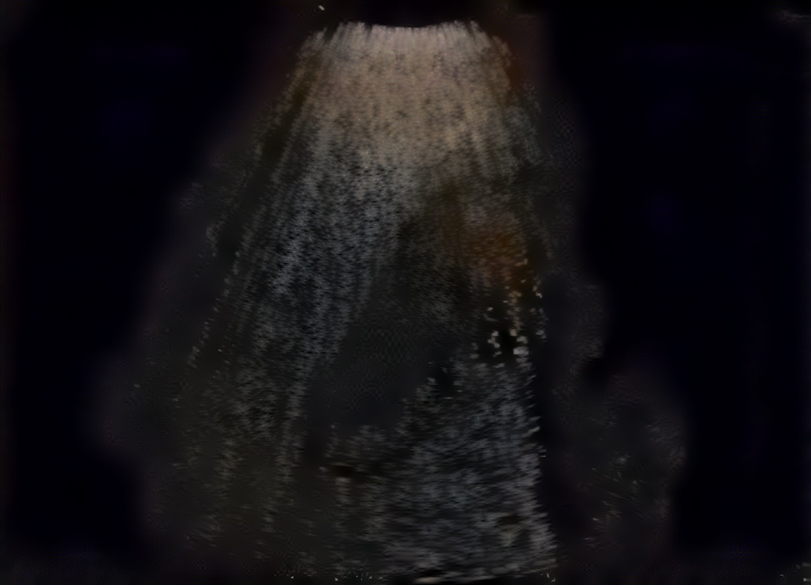
LQ to HQ - Optimization process - 3 10 epochs (5-6)

Slide 6
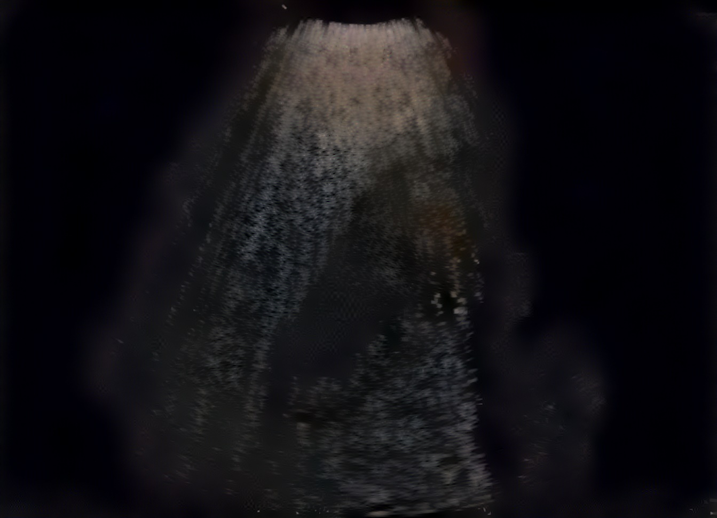
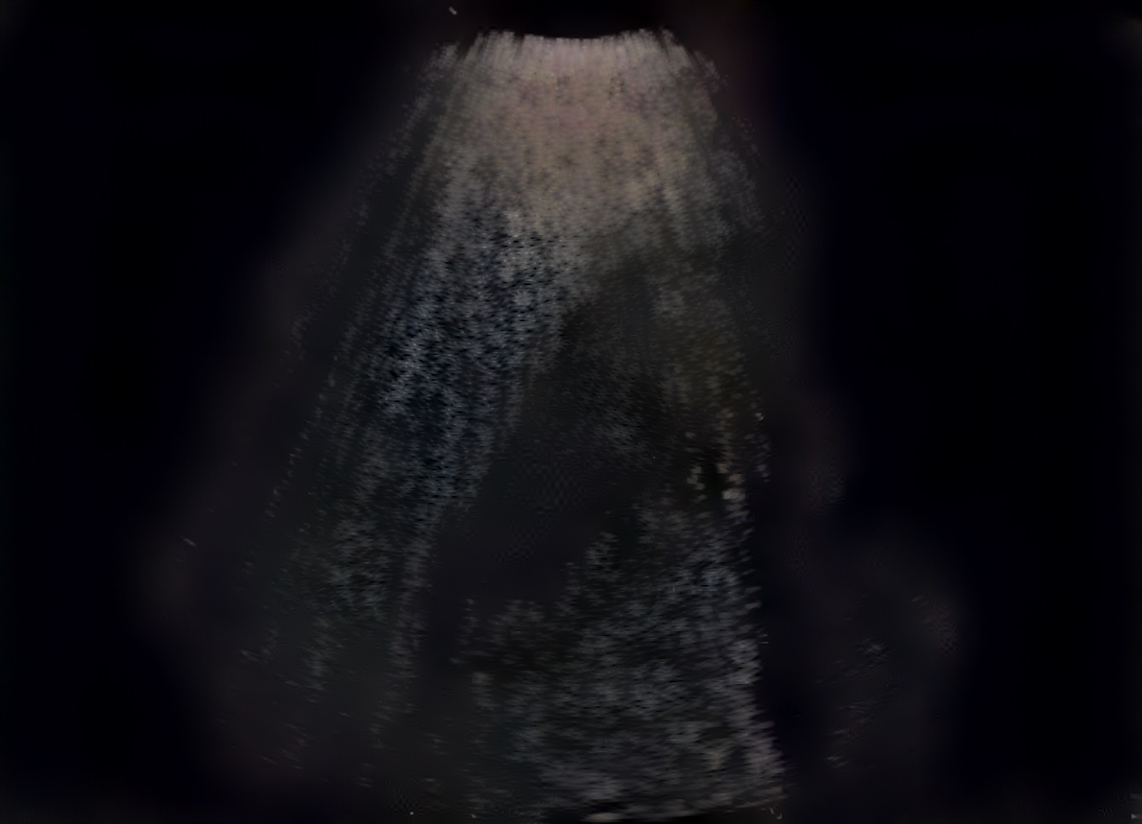
LQ to HQ - Optimization process - 4 10 epochs (7-8)

Slide 7
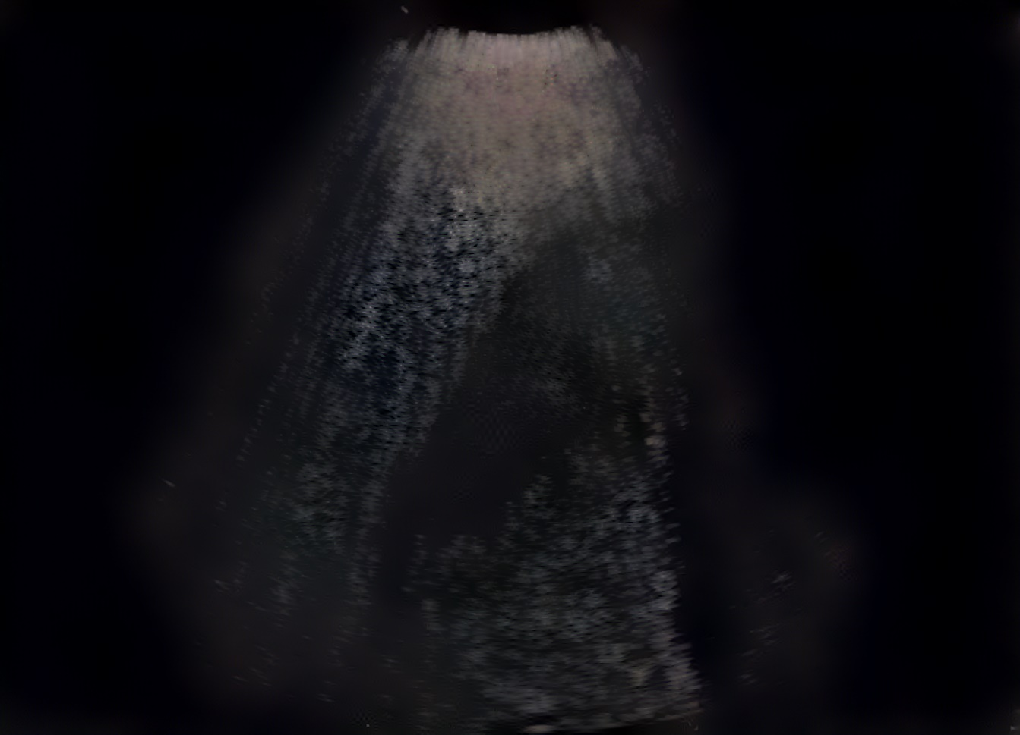
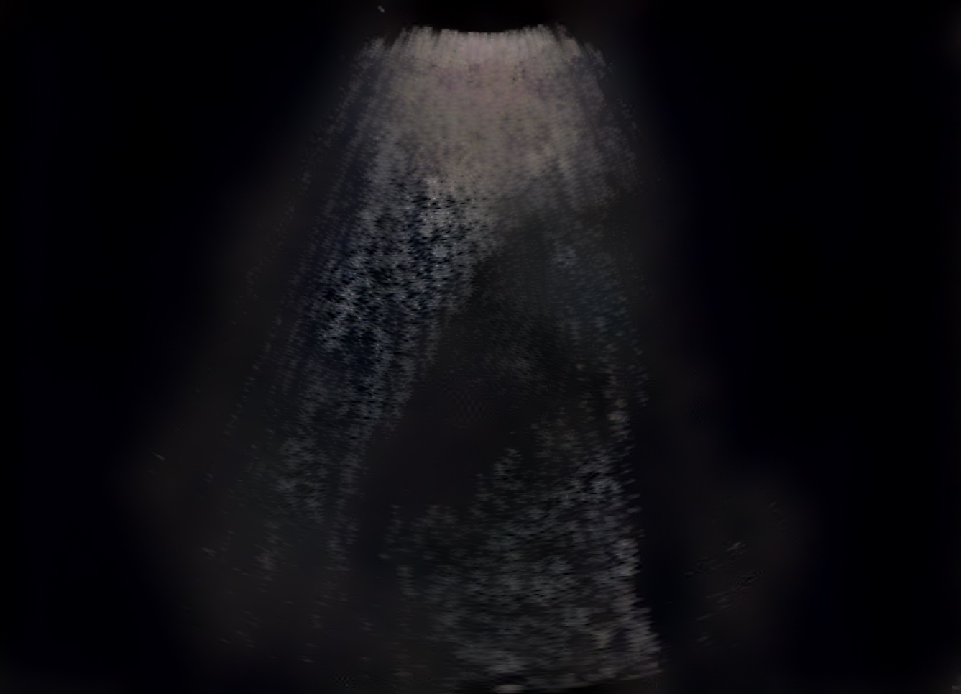
LQ to HQ - Optimization process - 5 10 epochs (9-10)

Slide 8

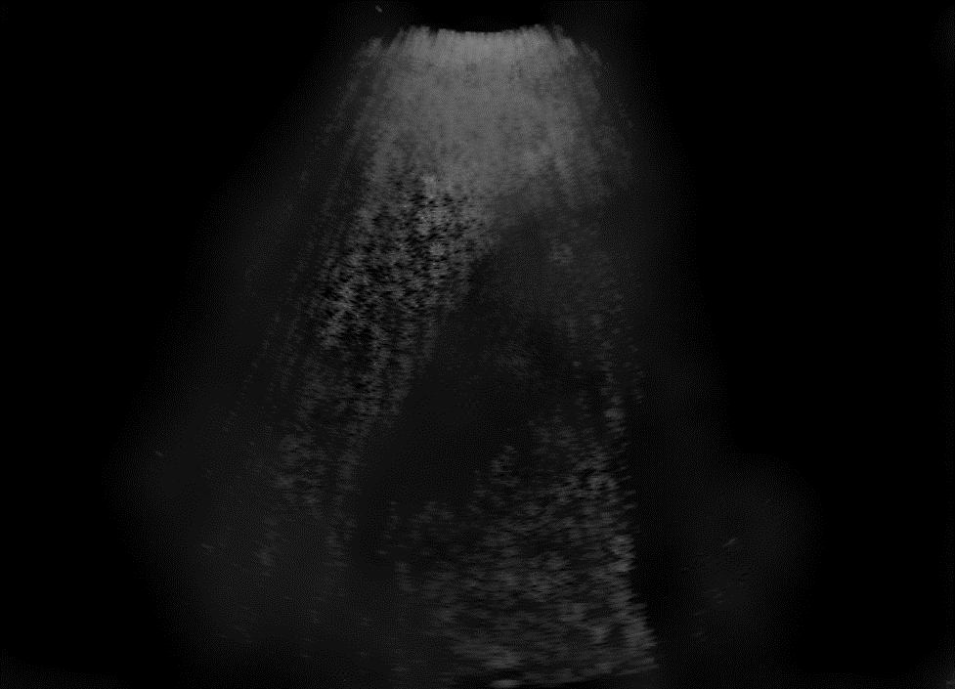
Some results (LQ to HQ)
Content
Style
Transfer

Slide 9
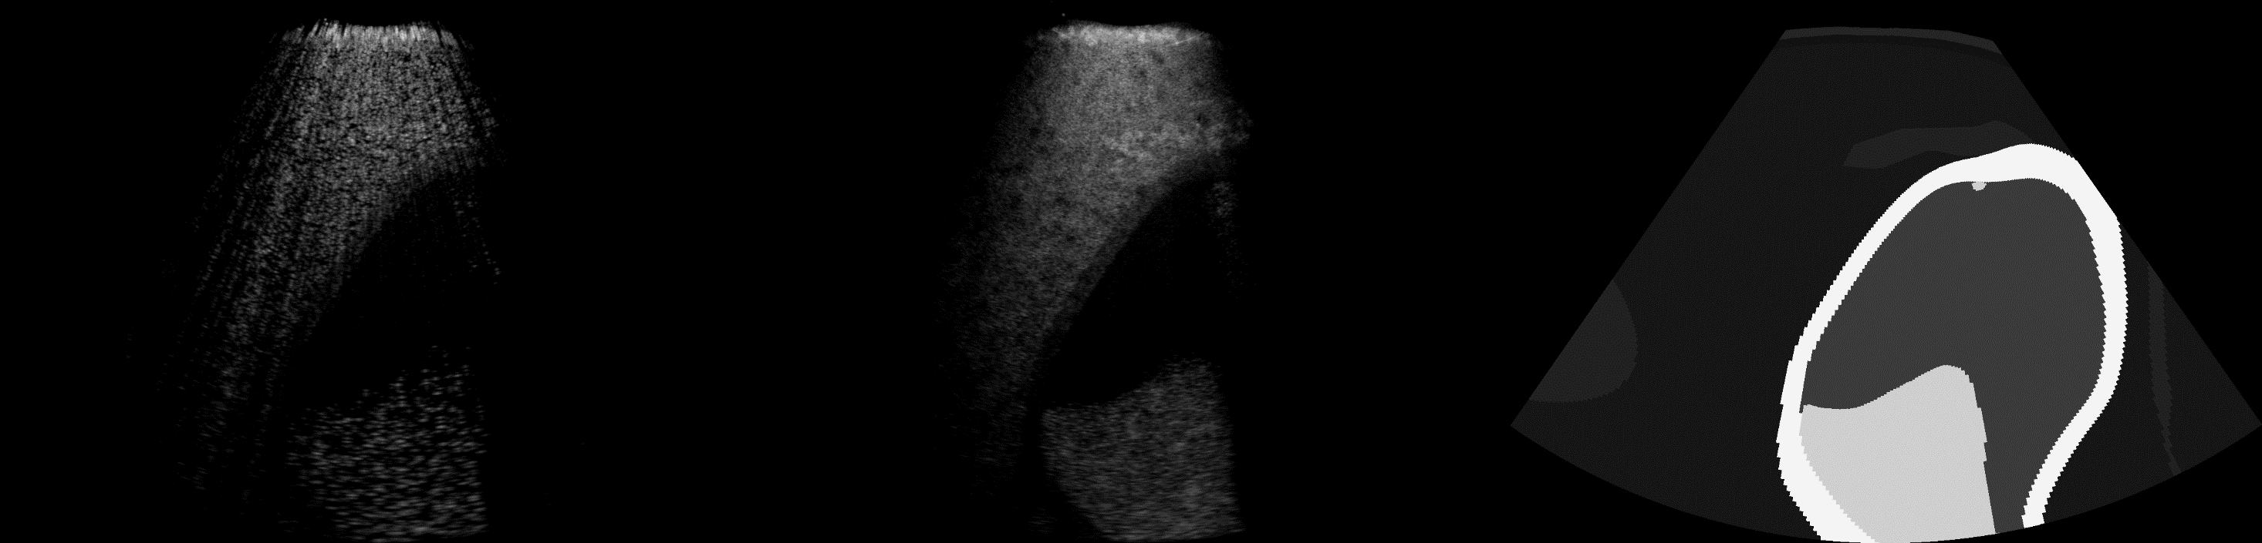
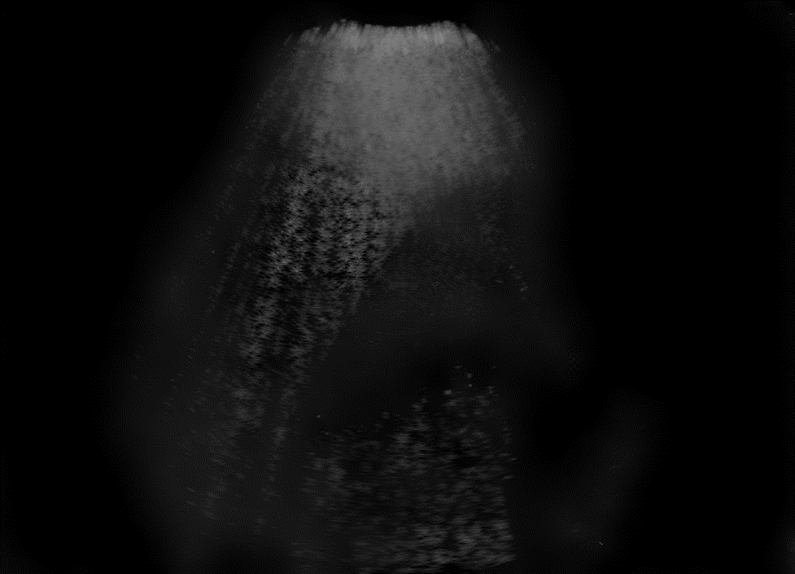
Some results (LQ to HQ)
Content
Style
Transfer

Slide 10
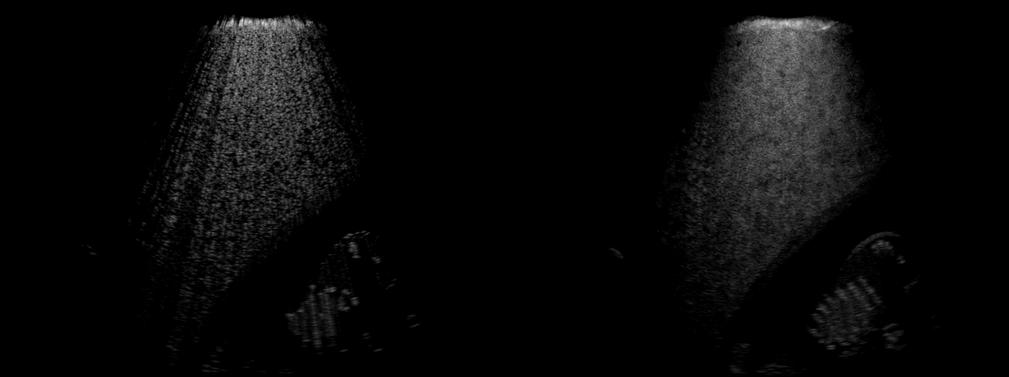
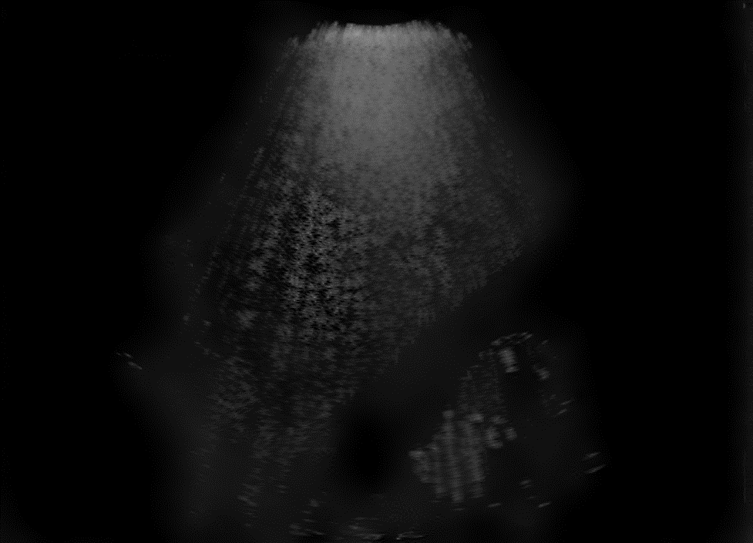
Some results (LQ to HQ)
Content
Style
Transfer

Slide 11
Some results (LQ to HQ)
Content
Style
Transfer

Slide 12

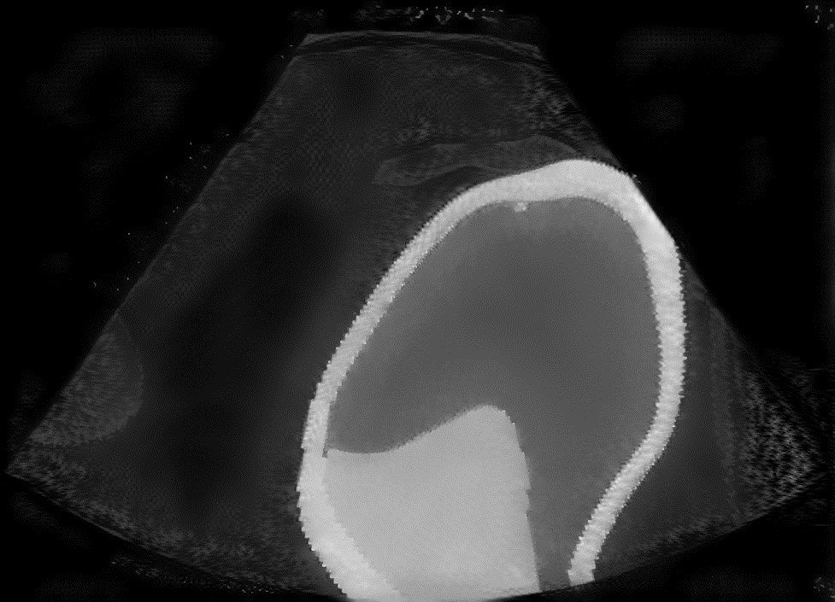
Some results (segmentation to HQ)
Content
Style
Transfer

Slide 13
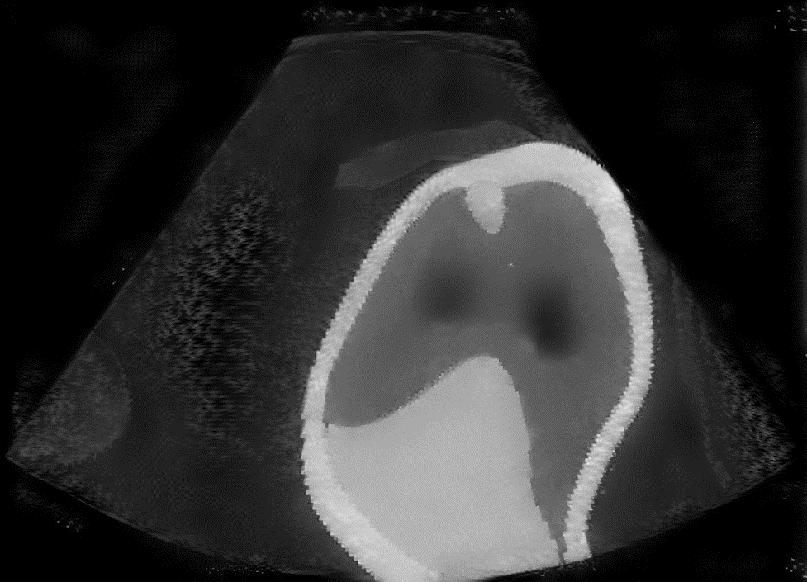
Some results (segmentation to HQ)
Content
Style
Transfer

